Slide 1
02
Working with Files, Texts, and Regular Expressions
Python Programming for Linguists
Ingo Kleiber, 2020

Slide 2
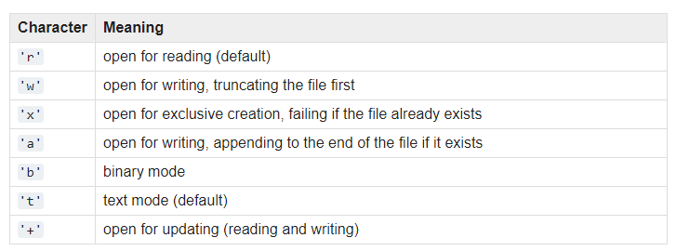
1. Reading and Writing Files
with open(‘file.txt’, ‘r’) as f:
data = f.read()
Open File
Read File
mode
Close File
data = f.read(10)
data = f.readlines()
https://docs.python.org/3/library/functions.html#open

Slide 3
2. Working with Text
Note: Since Python 3.0, str are stored as Unicode (UTF-8 by default)
Strings (str objects) are sequences of characters (Unicode code points)
s = ‘ABC’
0 | 1 | 2
A | B | C
print(s[0:2]) → ‘AB’
start:stop

Slide 4
2. Working with Text
s = ‘Hello World’
String Methods
s.upper() & s.lower()
s.find(‘World’)
s.isdigit()
s.split()
s.replace(find, replace)
…

Slide 5
3. Regular Expressions
import re
re.search(pattern, string)
re.findall(pattern, string)
re.split(pattern, string)
re.sub(pattern, rpattern, string)
Match Objects

Slide 6

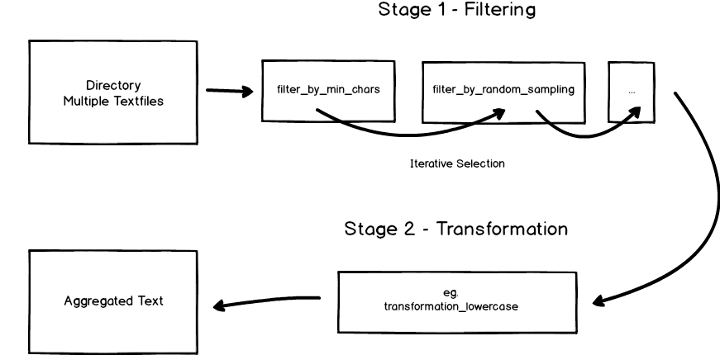
4. TextDirectory
https://github.com/IngoKl/textdirectory

